Slide 1

Smart Plant Monitoring
By Team Exemplary
Asm Nurussafa
Tasawar Siddiquy Arfat Kamal
Nirojan Navaratnarajah
For the module Advanced Embedded System.
Picture source: https://www.vecteezy.com/vector-art/3223354-smart-plant-pot-icon-on-white

Slide 2
Agenda
Motivation. (Arfat)
Concept description . (Arfat)
Technologies used. (Tasawar)
Applications and use cases. (Nurussafa)
Implementation description. (Neero)
Video demonstration. (Neero)
Summary.

Slide 3
Motivation

Slide 4
2. Concept Description

Slide 5
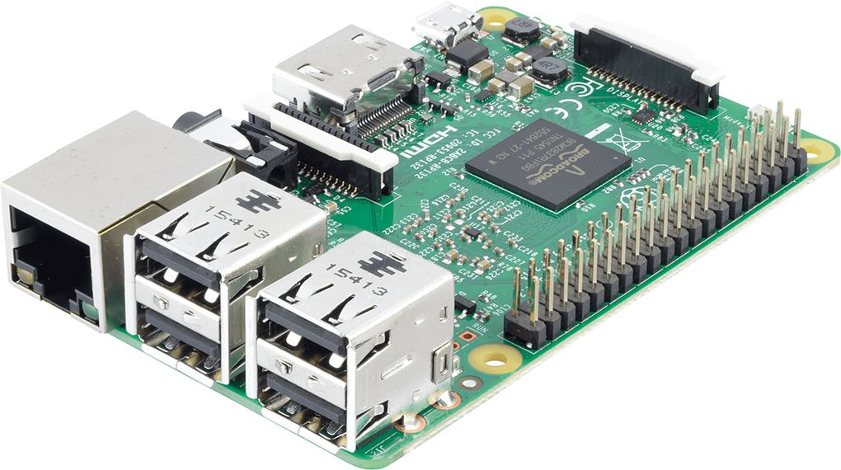
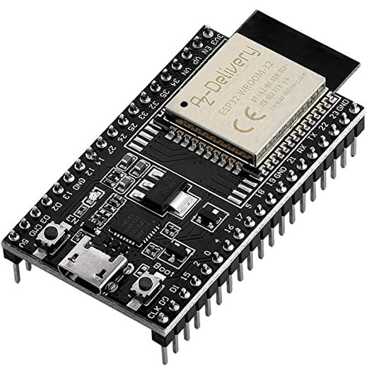
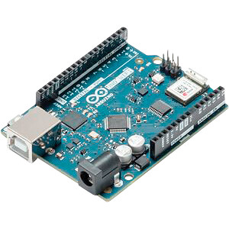

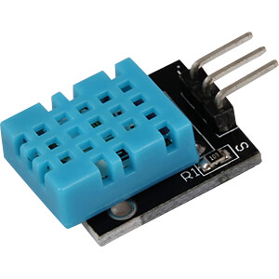
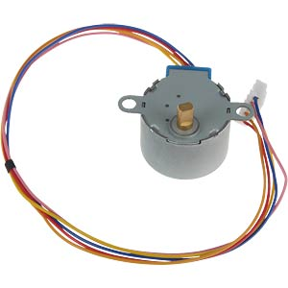
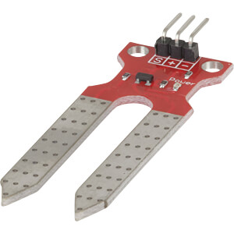
Hardware components used in the project.
Broker
Client 01
[1]
Client 02
Client 03
[5]
[4]
[2]
[7]
[6]
[3]

Slide 6
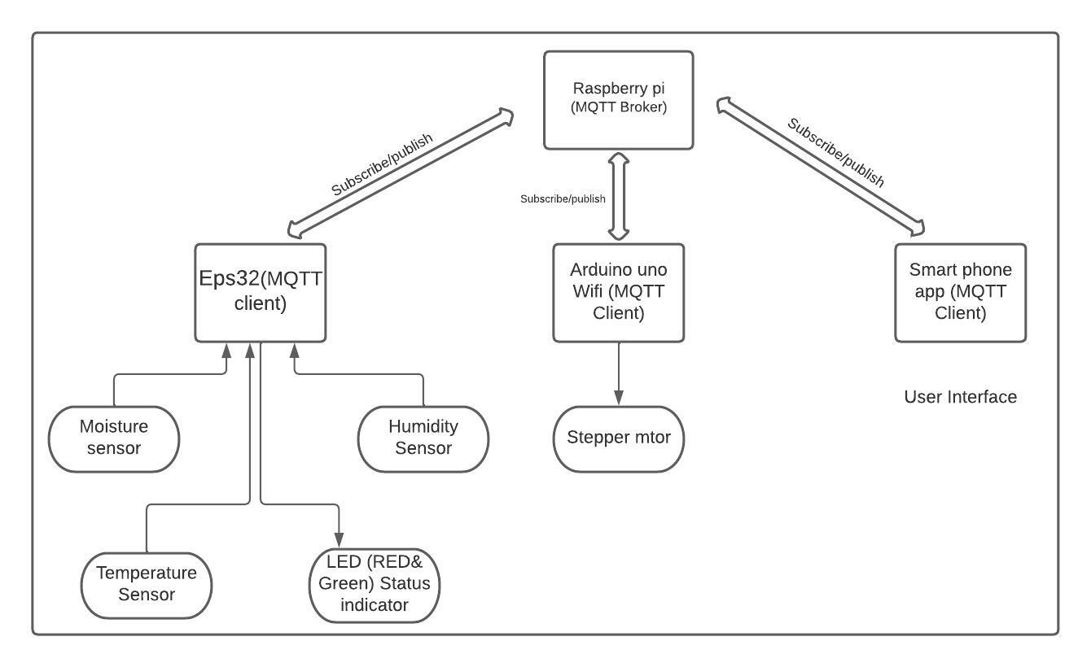
Block diagram

Slide 7
3. Technologies

Slide 8
Temperature and Humidity Sensor (DHT11) & Soil Moisture Sensor (ME110)

Slide 9
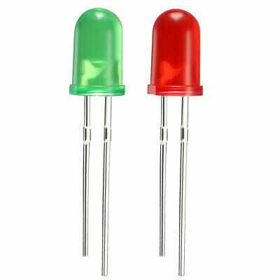
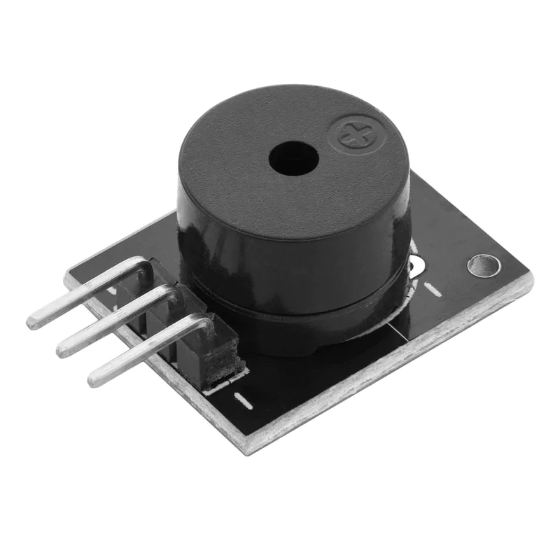
LED , Buzzer & Stepper motor

Slide 10
MQTT - Message Queuing Telemetry Transport
MQTT is a bi-directional communication protocol where each client can both produce and consume data by publishing messages and subscribing to topics

Slide 11
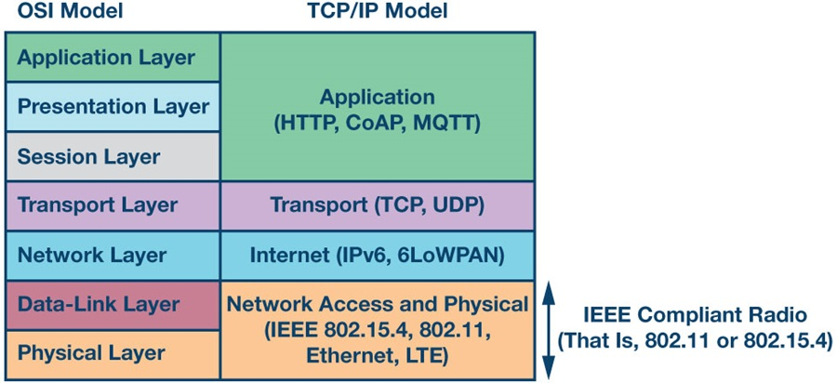
MQTT protocol is an Application layer protocol.
[8]

Slide 12
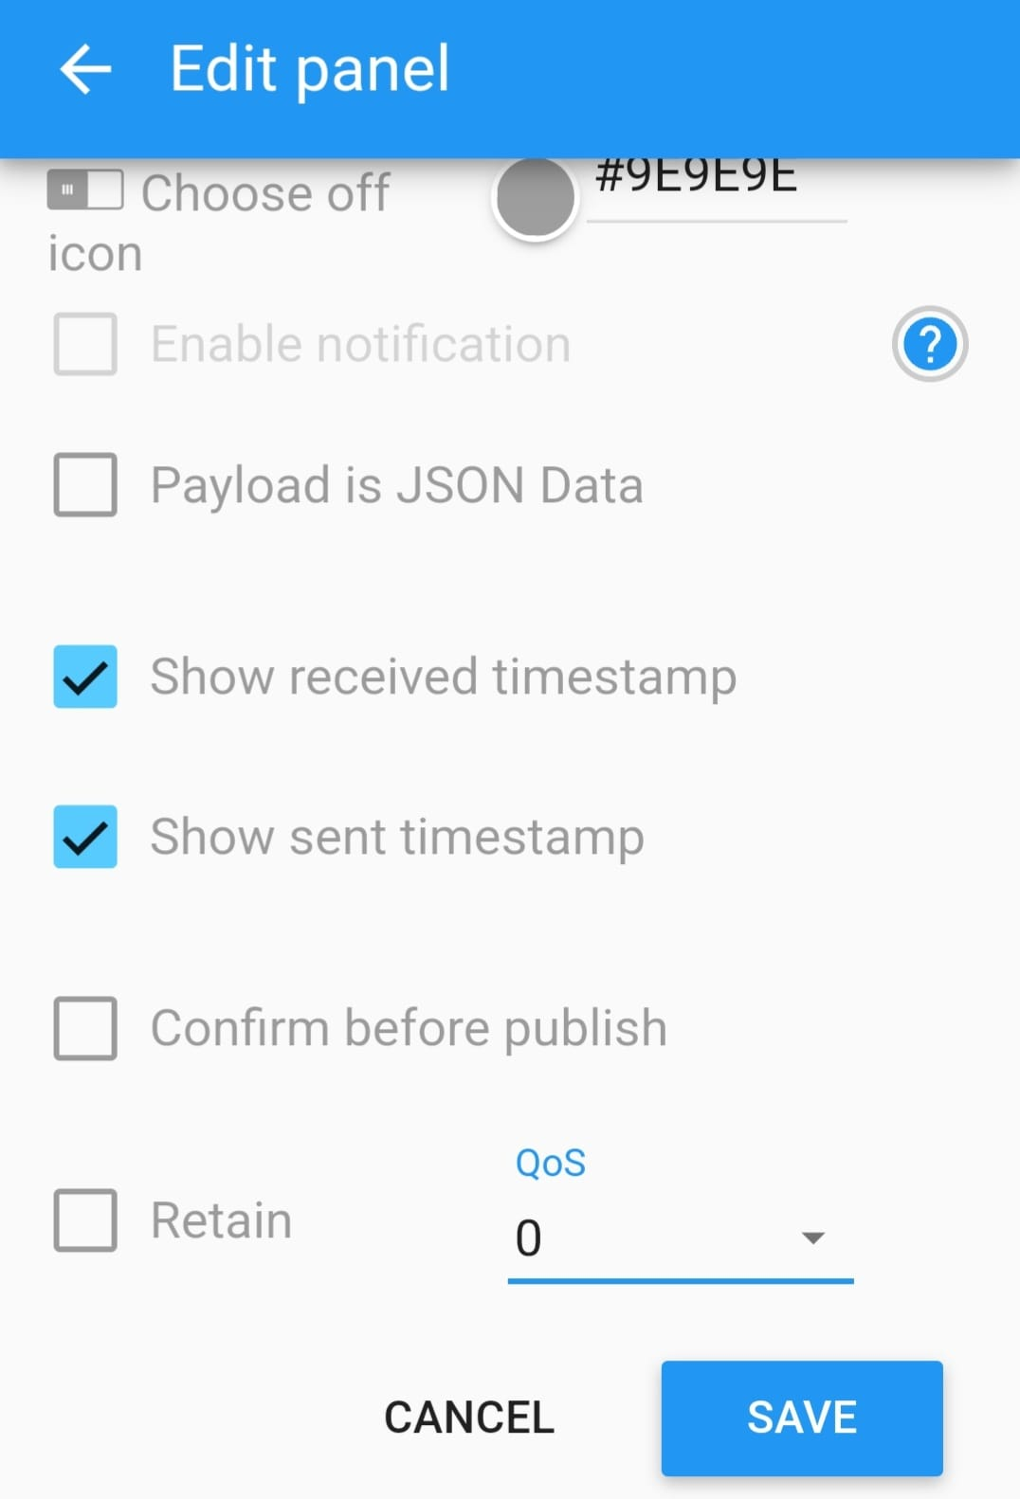
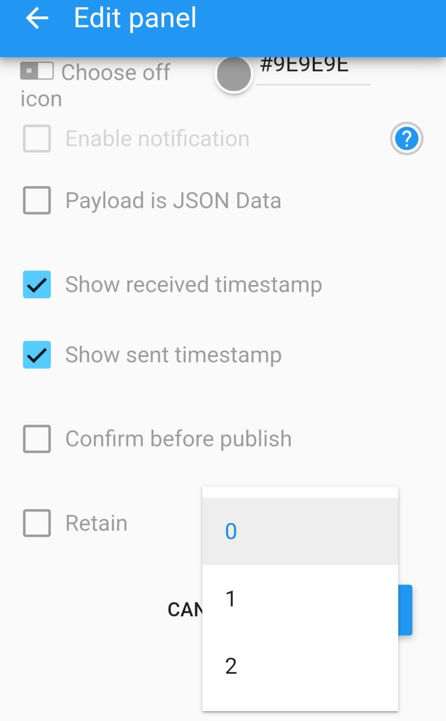
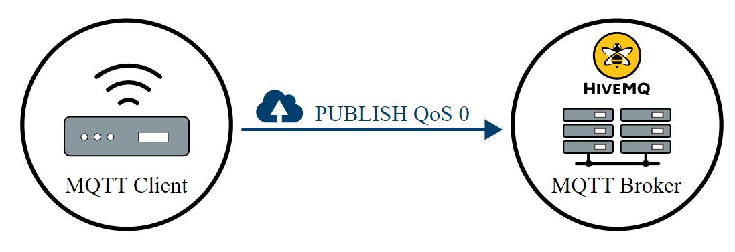
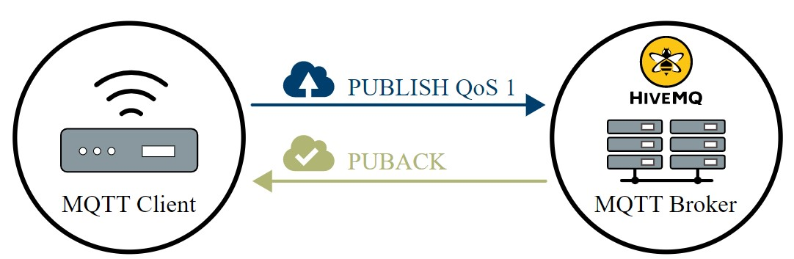
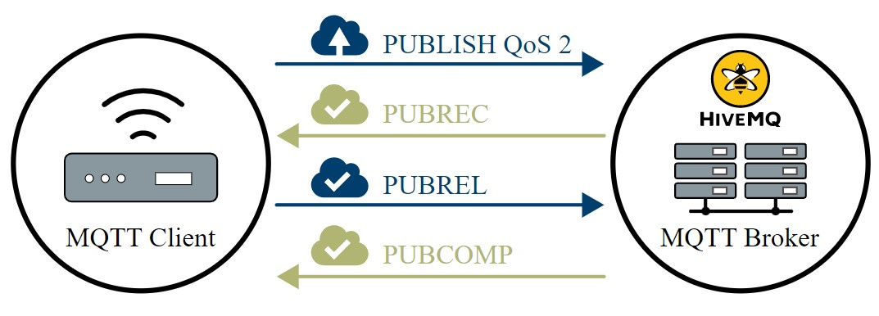
QOS Levels
There are 3 QoS levels in MQTT: (Quality of Service)
At most once (0)
At least once (1)
Exactly once (2).
[2]

Slide 13
4. Application and use cases

Slide 14
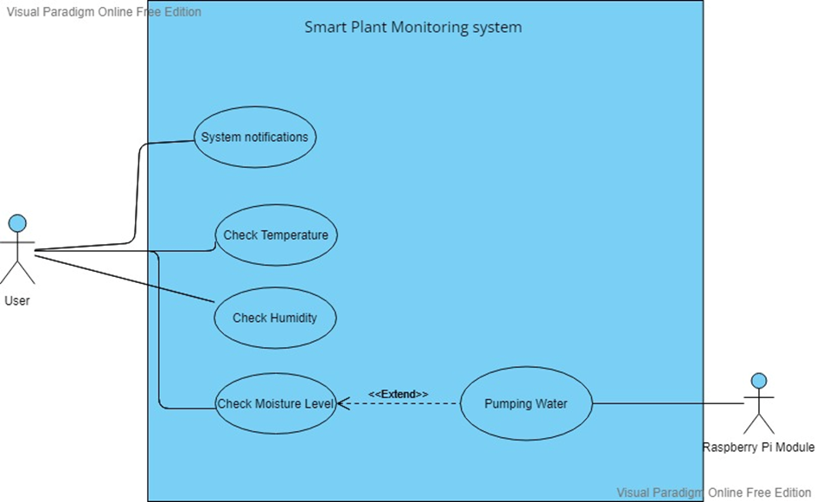
Use cases:

Slide 15
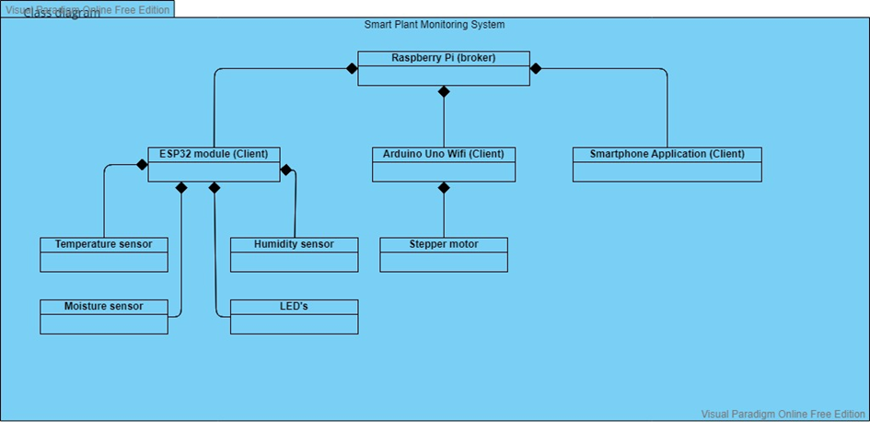
Class diagram:

Slide 16
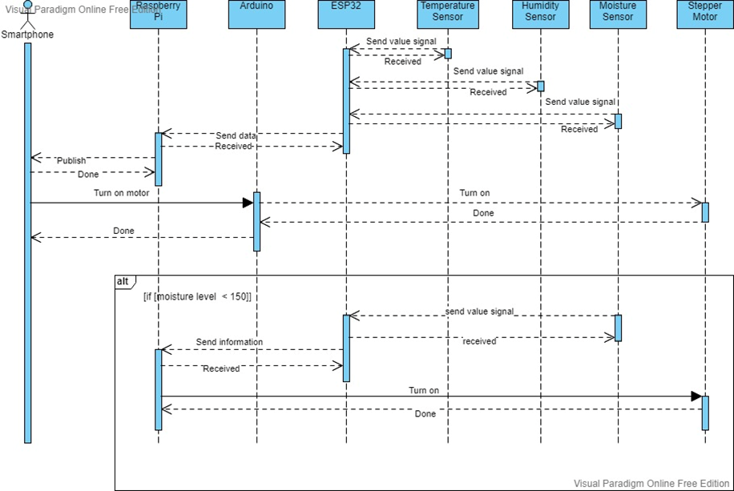
Sequence diagram:

Slide 17
5. Implementation description

Slide 18
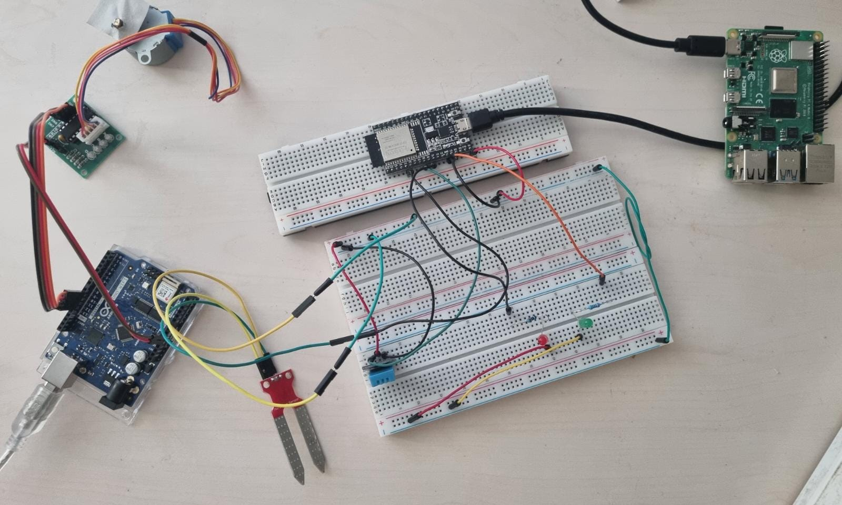
Static structure

Slide 19
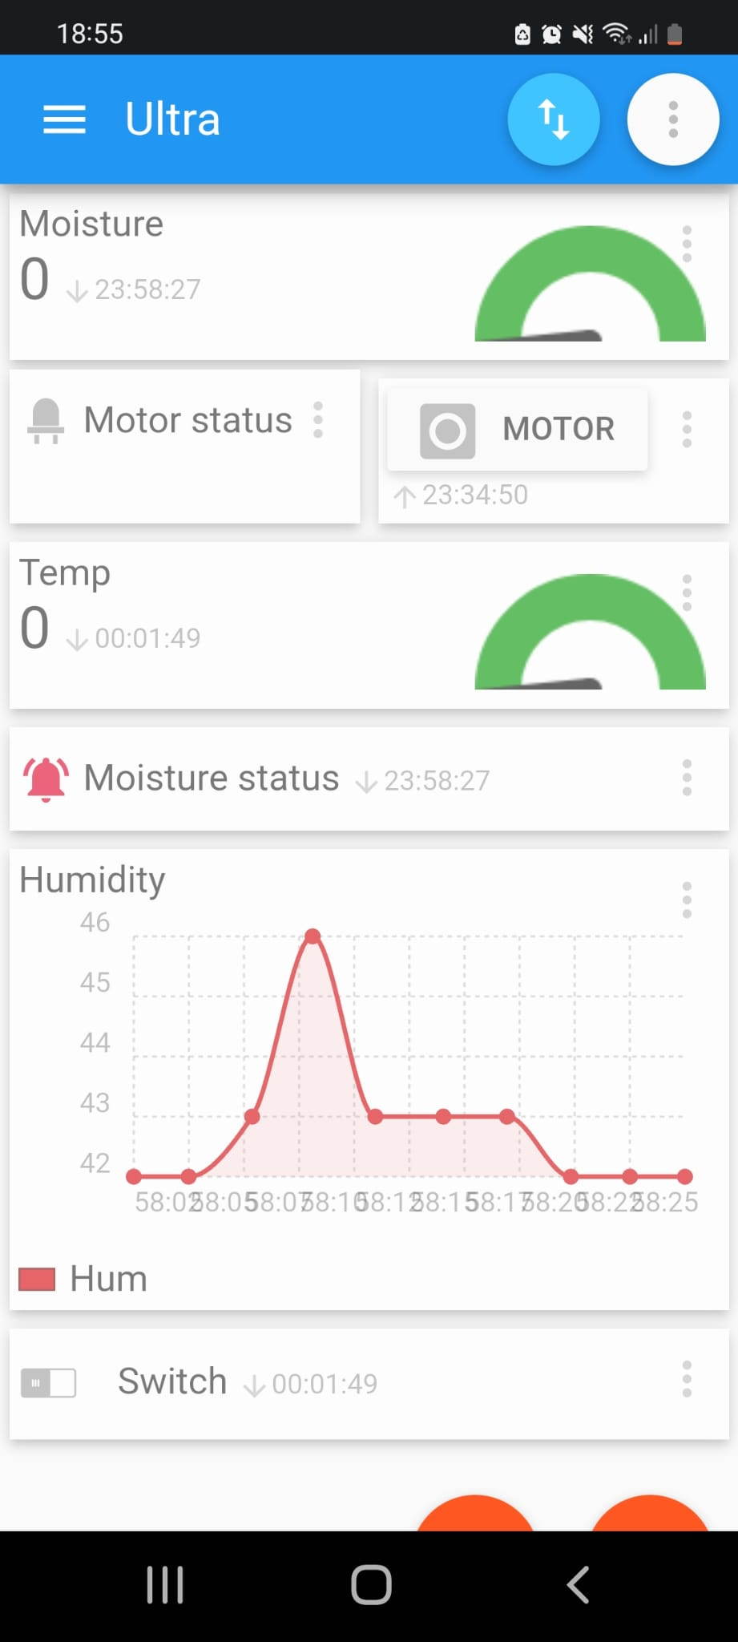
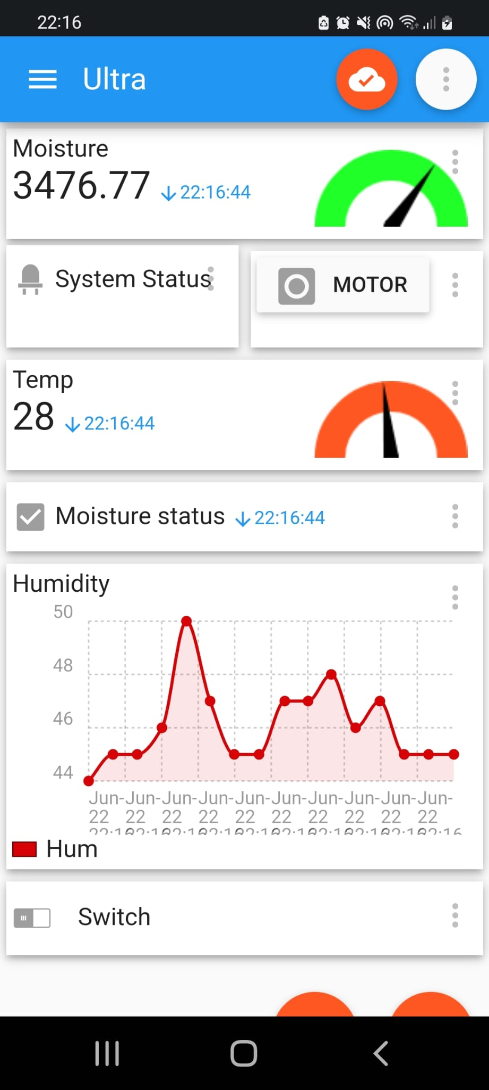
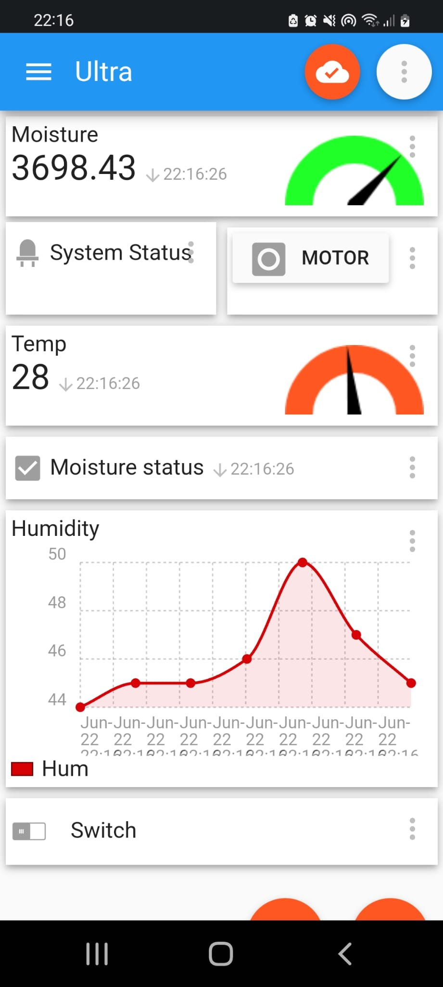
User Interface

Slide 20
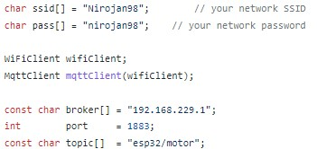
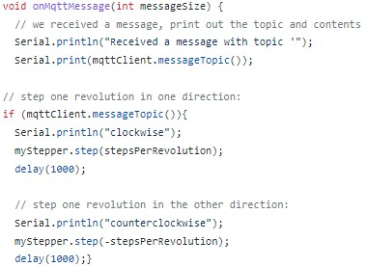
Arduino code

Slide 21

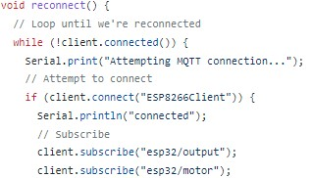
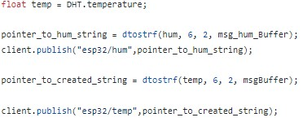
Esp32 code

Slide 22

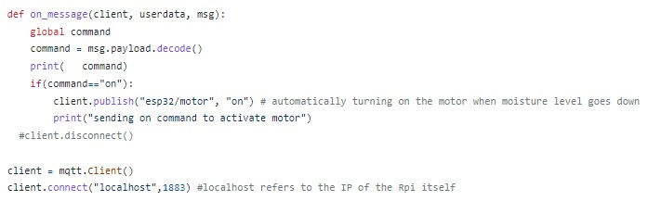
Automating the whole process of watering the plant
A simple python script is implemented to monitor the changes in the moisture level of the soil.

Slide 23
6. Video Demonstration

Slide 24
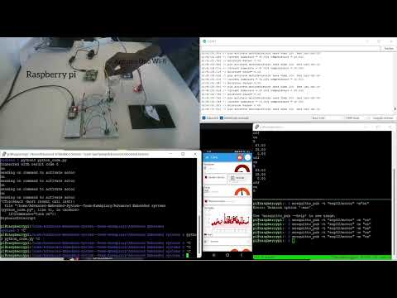

Slide 25
7. Summary
How IoT and WSN have been integrated in the domain project.
How such sensors and actuators technologies have been used in our project.
How we can describe such a project using diagrams.
How MQTT communication protocol has been used in our project.
How we can establish communication between ESP32, Arduino and Raspberry Pi.
How we use different programming interfaces together for such a project.

Slide 26
References
Github repository- https://github.com/Asm-Nurussafa/Advanced-Embedded-System--Team-Exemplary
[1] https://www.distrelec.de/de/raspberry-pi-modell-gb-ram-raspberry-pi-raspberry-pi-model/p/30085264
[2]https://www.reichelt.de/entwicklerboards-temp-feuchte-dht-11-debo-bo-dht-11-p239086.html?PROVID=2788&gclid=CjwKCAjwtcCVBhA0EiwAT1fY7y57Nj8I8es0CEmqigvr6Wq0yGRKT4GLmyhwdNRq4uctxCmUWw0o7hoCi3sQAvD_BwE
[3]https://www.reichelt.de/arduino-feuchtesensor-fuer-bodenfeuchte-ard-sen-wet1-p282511.html?PROVID=2788&gclid=CjwKCAjwtcCVBhA0EiwAT1fY79TXnUVht3-BB0SvqBkxO_Metz4OtC305AhsqlU8XDhH7D93AqykkhoCj_0QAvD_BwE
[4] https://www.amazon.de/ESP-32-Dev-Kit-V4-Parent/dp/B07Z83MF5W?th=1
[5]https://www.reichelt.de/arduino-uno-wifi-rev2-atmega-4809-arduino-uno-rev2-p248661.html?PROVID=2788&gclid=CjwKCAjwtcCVBhA0EiwAT1fY72fjJJK2zmu35t0cO3TaVqIX53rqmufEVOivmeAEYSIqXZ9DDc4wwRoCFugQAvD_BwE
[6]https://www.reichelt.de/entwicklerboards-schrittmotor-inkl-steuerung-uln2003-debo-moto1-p192146.html?PROVID=2788&gclid=CjwKCAjwtcCVBhA0EiwAT1fY72AfZkL5vcBqoo4m-7V_FgP7vVCvEDnr6O2wXquNZuJG9z2Nv_P_wBoC5iMQAvD_BwE
[7] https://lovepik.com/image-610825885/life-series-hand-drawn-cartoon-mobile-phone-iphone.html
[8] https://www.analog.com/ru/technical-articles/intelligence-at-the-edge-part-3-edge-node-communication.html

